Slide 1
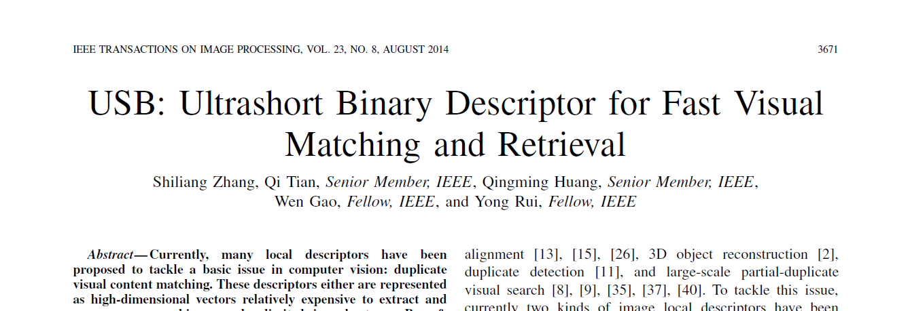
USB： Ultrashort Binary Descriptor for Fast Visual Matching and Retrieval
谭伟敏，14110240025

Slide 2
Outline
1. Background
2. USB descriptor extraction
24 bit USB
64 bit spatial feature
3. Application
Cascade verification for image matching
Image Indexing and Retrieval
4. Experiment
5. Conclusion

Slide 3
Background
MATCHING duplicate visual contents among images is a basic research issue.
Notes:
Expensive for extraction and similarity computation
Not compact enough
A widely used solution to speed up SIFT matching is to generate Bag-of-visual Words (BoWs) model. The BoWs model quantizes SIFTs into compact visual words, hence allows for fast matching。
thus, USBs could be directly used as visual words but avoid the expensive codebook training, high dimensional descriptor extraction, and quantization. Spatial Verification

Slide 4













Background
Computational& Storage
& Efficiency
Codebook Training
Image Indexing
Feature Extraction
Feature Quantization
Post Processing
……
Query Image
Lookup Index
Retrieval Results
Binary Local Descriptor:
Binary SIFT (TIP 2014, MM 2012)
Edge-SIFT (TIP 2013)
COGE (PCM 2013 Best Paper)
USB (TIP 2014)
Notes:
Expensive for extraction and similarity computation
Not compact enough
A widely used solution to speed up SIFT matching is to generate Bag-of-visual Words (BoWs) model. The BoWs model quantizes SIFTs into compact visual words, hence allows for fast matching。
thus, USBs could be directly used as visual words but avoid the expensive codebook training, high dimensional descriptor extraction, and quantization. Spatial Verification

Slide 5
Outline
1. Background
2. USB descriptor extraction
24 bit USB
64 bit spatial feature
3. Application
Cascade verification for image matching
Image Indexing and Retrieval
4. Experiment
5. Conclusion

Slide 6
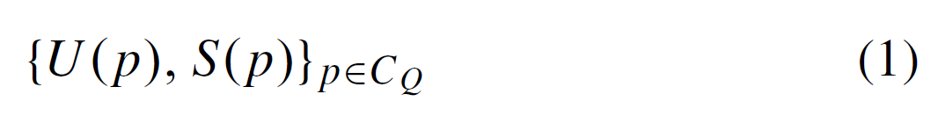
USB DESCRIPTOR EXTRACTION
Ultra-short Binary Descriptor (USB)
U(p) : USB extracted from image patches surrounding keypoint p. 24-bit
S (p) : Spatial feature extracted at keypoint p, 64-bit
Application
Image matching
Large-scale Retrieval on 1.3 million images
Notes:
p is a keypoint in image Q, CQ represents the collection of detected keypoints in Q. We use U(p) and S(p) to denote the USB and spatial feature extracted at keypoint p, respectively.

Slide 7

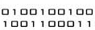

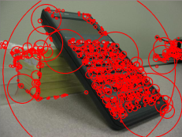
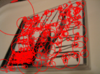

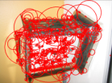
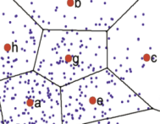
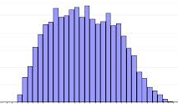
Ultra-Short Binary Descriptor (USB)
24 bit USB
d
d
h
Image Patch
a
b
f
c
s
Interest Points Detection
Bag-of-USBs
64 bit Spatial Feature
Proposed
Spatial Configuration
Traditional
Training images
Codebook training
Large number of local descriptors
d
d
h
a
b
f
c
s
Interest points detection
Image patch
Descriptor extraction
Descriptor quantization
Bag-of-visual Words
Notes:
This slides show our idea how to extract a compact and discriminative local descriptor. We first detect keypoints from image like the traditional approaches. Then, from each patch, we extract a compact 24 bit descriptor, we call it as usb which means the ultra compact binary descriptor. We found the 24 bit descriptor is too compact to beat the state-of-the-art. Therefore, we further extract a complementary 64 bit spatial feature to describe the spatial configuration of this patch. Therefore, we find USB feature actually includes two parts: the 24 bit used feature and the 64 bit spatial feature. We use the 24 bit for indexing, and use the 64 bit for verification.

Slide 8
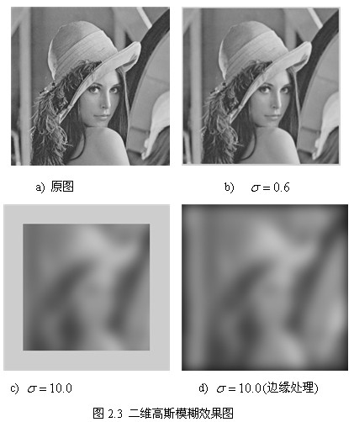
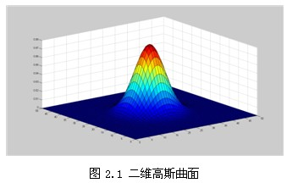
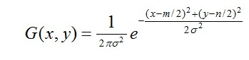
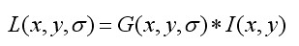
DoG (Difference of Gaussian)
高斯函数:
高斯函数与图像卷积：
Notes:
我的理解：频域上，高斯函数的傅里叶变换是它本身，对图像高斯卷积可以看成高斯函数形状的频谱和图像的频谱做点积，结果是低频被突出高频被抑制，sigma的大小决定低频/高频被突出/抑制的程度；空域上，是对窗口内像素的灰度/颜色取加权平均，sigma大权重差别小，图像越模糊，sigma小权重差别大。

Slide 9
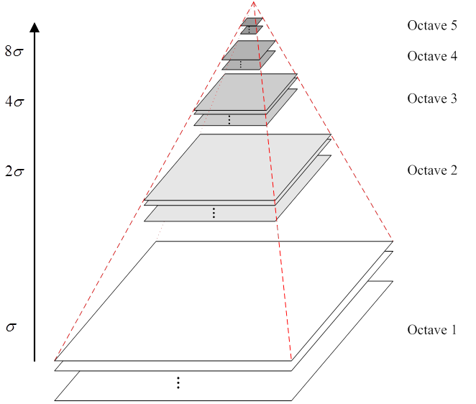
DoG (Difference of Gaussian)
( σ, k*σ, 2k*σ, 4k*σ . . . )
高斯金字塔

Slide 10
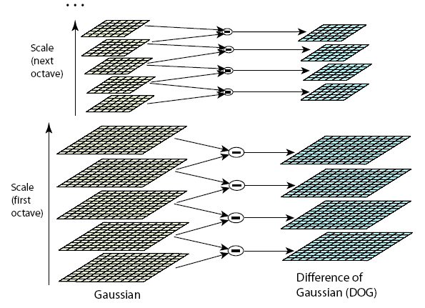
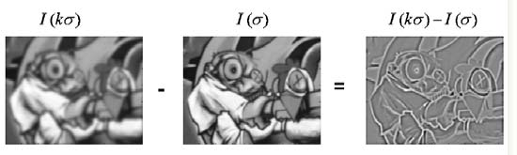
DoG (Difference of Gaussian)
D(x, y, σ) = (G(x, y, kσ) − G(x, y, σ)) ∗ I(x, y)
= L(x, y, kσ) − L(x, y, σ)
高斯差分金字塔

Slide 11
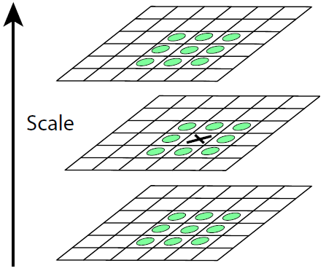
Local Extrema Detection
DoG (Difference of Gaussian)
keypoint
Maxima and minima
Compare x with its 26 neighbors at 3 scales
Post processing
除去不好的特征点
这一步本质上要去掉DoG局部曲率非常不对称的像素

Slide 12
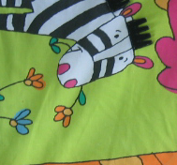


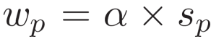
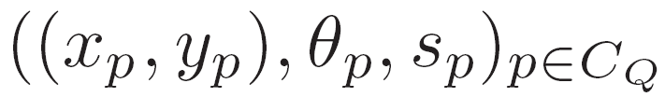
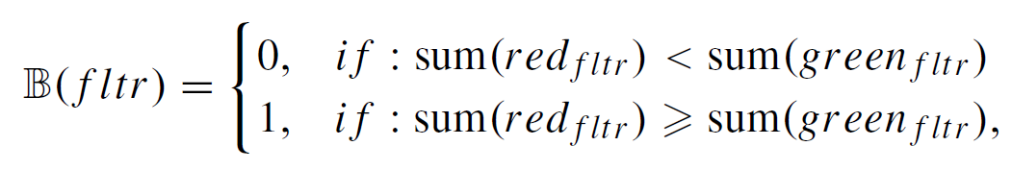
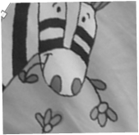
Raw binary descriptor extraction
1. Interest point detection
2. Scale orientation normalization
DoG
D
,α = 12
D
D = 36
3. Raw descriptor generation
Five Haar filters:
Fast to compute
Small correlation
More informative and robust than pixel level intensity comparison (ORB)
Generate a 9*5=45 bit raw descriptor
Notes:
We first introduce how we extract the 24 bit usb descriptor. We first detect interest points from images with DoG detector. The detected keypoints includes three aspects of information: the position, the scale of this descriptor, and the orientation of the descriptor. We extract a patch from each interest point, and set the size of this patch proportional to the scale of this interest point. Then, we do the scale and orientation normalization to the extract patch to make sure the patch after normalization in invariant to scale and rotation changes. Then, we divide the normalized patch into 3*3 sub patches, and extract 5 binary bins from each sub patch. The 5 binary bins are generated with these five harr filters. We compare the pixel sum in the red region with the sum in the green region to get the binary code. These five filters are fast to compute with integrated image. And they show small correlation to each other. More importantly it computes binary codes by comparing image patches, this is more robust than ORB which computes binary codes by comparing the intensity of single pixels. Therefore, we could generate a 45 bit raw descriptor.

Slide 13
24-bit USB
45-bit : still too long
24-bit USB
To maximize the visual clue preserved in a limited number of binary bins, each bin should satisfy two criteria:
1) low correlation to the others.
2) high entropy, i.e., evenly distributed on 0 and 1 on a large number of images, which produces small mean-to-0.5. distance
in Eq. (5).
Notes:
We first introduce how we extract the 24 bit usb descriptor. We first detect interest points from images with DoG detector. The detected keypoints includes three aspects of information: the position, the scale of this descriptor, and the orientation of the descriptor. We extract a patch from each interest point, and set the size of this patch proportional to the scale of this interest point. Then, we do the scale and orientation normalization to the extract patch to make sure the patch after normalization in invariant to scale and rotation changes. Then, we divide the normalized patch into 3*3 sub patches, and extract 5 binary bins from each sub patch. The 5 binary bins are generated with these five harr filters. We compare the pixel sum in the red region with the sum in the green region to get the binary code. These five filters are fast to compute with integrated image. And they show small correlation to each other. More importantly it computes binary codes by comparing image patches, this is more robust than ORB which computes binary codes by comparing the intensity of single pixels. Therefore, we could generate a 45 bit raw descriptor.

Slide 14
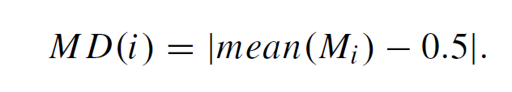
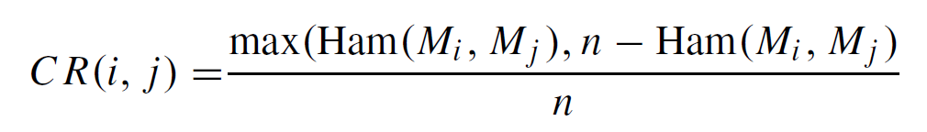
24-bit USB
24-bit USB : Binary bin selection
Greedy search criteria:
1. large variations (mean-to-0.5 distance)
2. minimum correlation with selected bins :
Select 24 bins (24-bit USB: U(p) <----> 2²⁴ IDs)
M 矩阵，45-bit x n (n=10)
Bin 1
1 | 1 | 1 | 1 | 1 | 1 | 0 | 0 | 0 | 0
. . . |  |  |  |  | . . . |  |  |  | . . .
Bin 2
Bin 3
Bin i
Bin 44
Bin 45
1 2 3 4 5 6 7 8 9 10
Notes:
The 45 bit is still too long to be indexable with inverted indexes. Therefore, we will generate a more compact descriptor from the raw binary descriptor. We propose a binary bin selection to select the most informative bins from the raw descriptor. We use a greedy search strategy to select bins satisfying two constraints: 1 large variation. 2 minimum correlation with selected bins. Based on these strategy we selected 24 bins from the 45 bins. We take the 24 bin as the 24bit usb feature. The usb directly corresponds to about 16 million unique IDs, hence it could be straightforwardly used for indexing.
These two figures shows the comparsion of variation and correlation between usb and the raw 45 bit raw descriptor. It is clear that the selected 24bins show larger variation and small correlation than the original 45 bins.

Slide 15
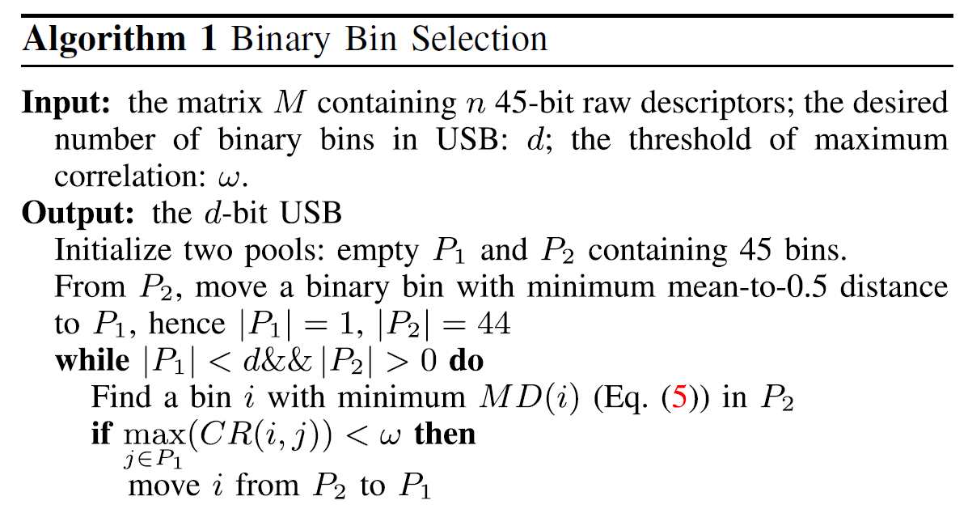
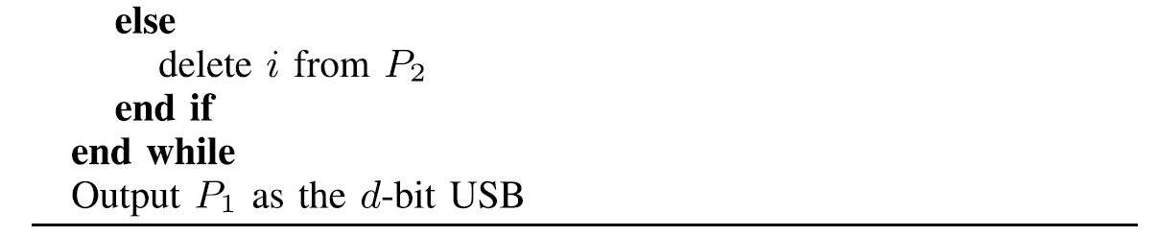
24-bit USB
Notes:
The 45 bit is still too long to be indexable with inverted indexes. Therefore, we will generate a more compact descriptor from the raw binary descriptor. We propose a binary bin selection to select the most informative bins from the raw descriptor. We use a greedy search strategy to select bins satisfying two constraints: 1 large variation. 2 minimum correlation with selected bins. Based on these strategy we selected 24 bins from the 45 bins. We take the 24 bin as the 24bit usb feature. The usb directly corresponds to about 16 million unique IDs, hence it could be straightforwardly used for indexing.
These two figures shows the comparsion of variation and correlation between usb and the raw 45 bit raw descriptor. It is clear that the selected 24bins show larger variation and small correlation than the original 45 bins.

Slide 16
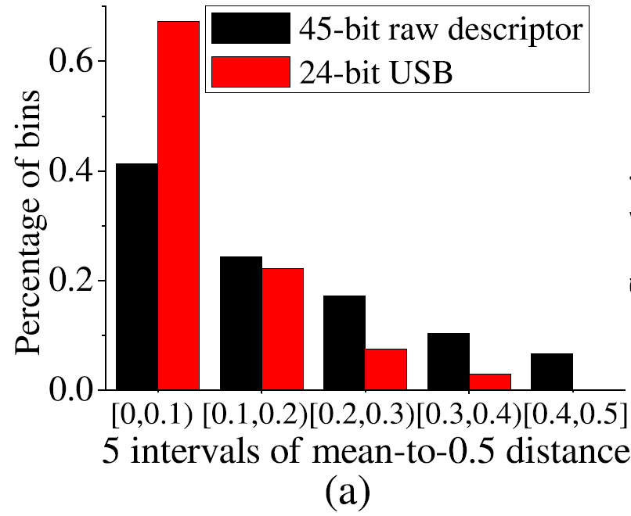
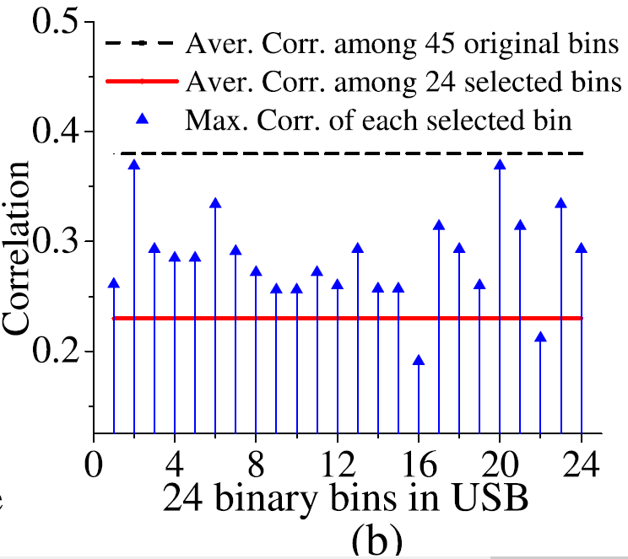
24-bit USB
Variation: 24 bit USB vs. 45-bit raw descriptor
Correlation: 24 bit USB vs. 45-bit raw descriptor
mean-to-0.5 distance
Notes:
The 45 bit is still too long to be indexable with inverted indexes. Therefore, we will generate a more compact descriptor from the raw binary descriptor. We propose a binary bin selection to select the most informative bins from the raw descriptor. We use a greedy search strategy to select bins satisfying two constraints: 1 large variation. 2 minimum correlation with selected bins. Based on these strategy we selected 24 bins from the 45 bins. We take the 24 bin as the 24bit usb feature. The usb directly corresponds to about 16 million unique IDs, hence it could be straightforwardly used for indexing.
These two figures shows the comparsion of variation and correlation between usb and the raw 45 bit raw descriptor. It is clear that the selected 24bins show larger variation and small correlation than the original 45 bins.

Slide 17
USB DESCRIPTOR EXTRACTION
Ultra-short Binary Descriptor (USB)
U(p) : USB extracted from image patches surrounding keypoint. 24-bit
S (p) : Spatial feature extracted at keypoint p, 64-bit
Application
Image matching
Large-scale Retrieval on 1.3 million images
Notes:
p is a keypoint in image Q, CQ represents the collection of detected keypoints in Q. We use U(p) and S(p) to denote the USB and spatial feature extracted at keypoint p, respectively.

Slide 18
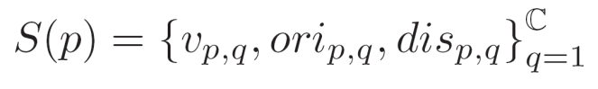
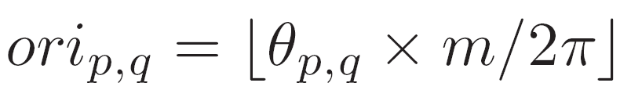
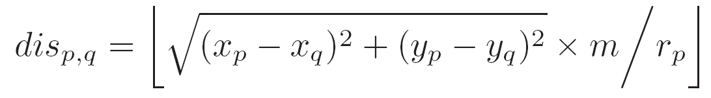
64-bit Spatial feature
24 bit: too compact to beat state-of-the-art
Use complementary spatial feature to improve precision
Visual Feature: First 8 bit of q’s USB
Orientation Relationship:
where θp,q within [0, 2π)
Distance Relationship:
We set m = 16, hence ori and dis are encoded with 4 bits.
The final spatial feature is (8+4+4)*C bits (C =4)
Scale and rotation invariant
Select at most C interest points with similar scale, DoG response to p for stable co-occurrence relationship
Notes:
After extracting the 24 bit used, we found it performs better than the 24 bit orb and get similar performance with the 1 million vocabulary tree, but still cann’t outperform the state-of-the-art. Therefore, we further extract a 64 bit spatial feature to descrcibe the neighbor spatial configuration of each interest point. For an interest point p, we first define the size of its neighbor region as belta times its scale. Then in this region, we at most find c interest points with similar scale and dog repsonse to p. because the interest points with similar scale and dog response show simialr repeatability, this makes the extracted spatial feature more stable.
This is the definition to the spatial feature of interest point p. q one of the C neighbor keypoints. From each neighbor keypoint, we extract three aspects of information, the visual feature of p, we keep the first 8 bit of p usb as v p, q. The orientation relationship between q and p. the distance relationship between p and q. We quantize the orientation and distance relationship into m intervals. And set m as 16 therefore, oripq and dispq could be encoded with 4 bits. Therefore, the final spatial feature is 8+4+4 time C bits. Note that the extracted spatial feature is scale and oritation invariant.

Slide 19
Illustration of matched USBs
1-order match
2-order match
3-order match
4-order match
Estimates the spatial consistency in 4-orders (4-levels)
Higher order means larger confidence of correctness
Superior to many visual phrase features that are either too strict or too loose
Fast with hamming distance and cascade structure
Ensures high recall and precision
Notes:
This is the illustration of matched usbs. We have 1 to 4 order matches. The 1 order match means one of the neighbor keypoints could be matched. The 4 order match means 4 of the neighbor keypoints could be matched. Therefore, the matching order reasonably estimates the confindence of correctness. This is superior and more flxible than many visual phrase features which include fixed number of visual words. the usb matching is also very fast with hamming distance and cascade structure. Because of the cascade structure, we can set loose constraint in the

Slide 20
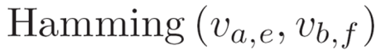
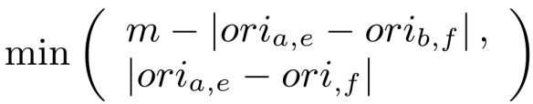
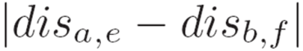
APPLICATION
1. Cascade verification for image matching
Basic Idea: correct matches are similar in : visual feature and spatial configuration
interest points a, b
USB Matching
Hamming(U(a), U(b))
= 3
Reject
Pickup e in S(a), f S(b)
Verify Visual Feature
Verify Orientation
Verify Distance
One Correct Match
> μ(3 )
Run at most C*C times of verification, C = 4.
Match order: Number of correctly matched neighbor points
Reject
Notes:
After extracting the usb and spatial feature, we can use it for image matching, because we has two aspects of information, the usb and spatial feature, we propose a cascade verification strategy. The basic idea is correct matches should be similar in visual feature and spatial configuration. Therefore, for two interest point, we first match their usb feature, if the hamming distance is less than a threshould, we then verify their spatial features. To verify the spatial feature, we pickup one neighbor keypoint from a and b then verify the spatial feature, orientation relationiship and distance relationship gradually. The neighbor keypoints passing these verifications are regarded as a correct match.
Because there are C neighbor keypoints in spatial feature, we run at most c*c times of verification. The number of neighbor keypoints passing verification is defined as the match order.

Slide 21
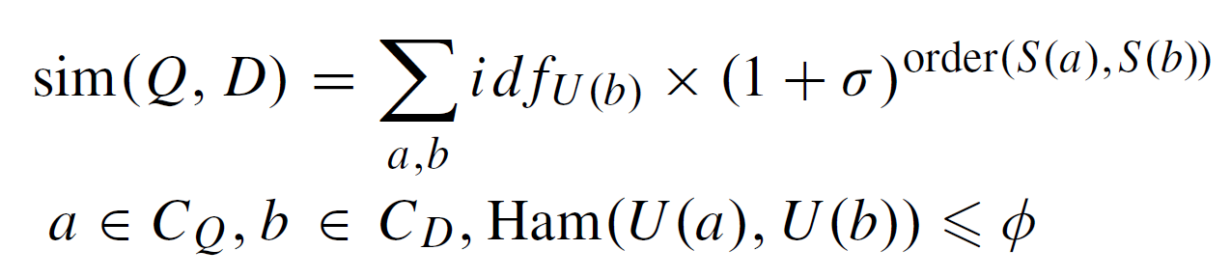
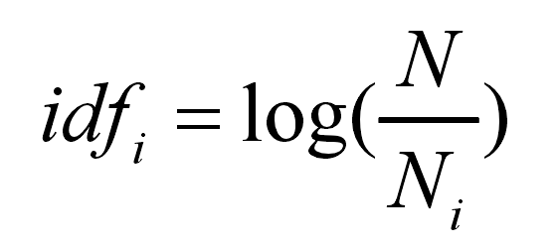
APPLICATION
2. Image Indexing and Retrieval
Where a and b are two keypoints from Q and D, whose USBs are similar enough, i.e., with Hamming distance less than φ.
σ : sets larger importance to high-order matches in image similarity computation
Notes:
After extracting the usb and spatial feature, we can use it for image matching, because we has two aspects of information, the usb and spatial feature, we propose a cascade verification strategy. The basic idea is correct matches should be similar in visual feature and spatial configuration. Therefore, for two interest point, we first match their usb feature, if the hamming distance is less than a threshould, we then verify their spatial features. To verify the spatial feature, we pickup one neighbor keypoint from a and b then verify the spatial feature, orientation relationiship and distance relationship gradually. The neighbor keypoints passing these verifications are regarded as a correct match.
Because there are C neighbor keypoints in spatial feature, we run at most c*c times of verification. The number of neighbor keypoints passing verification is defined as the match order.

Slide 22
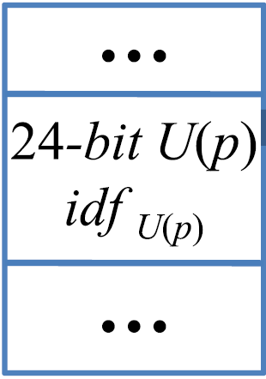
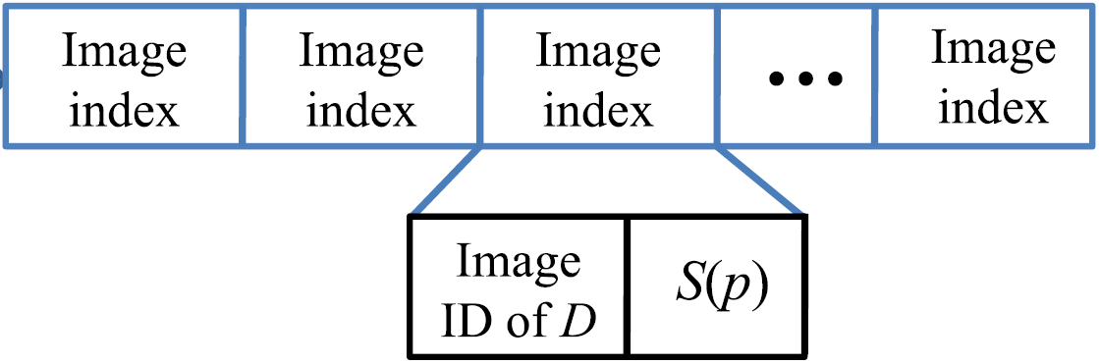






BoUs model
Most commonly used indexing strategy:
…
V_{i}
IDF(V_{i})
Indexed feature
Indexed feature
Indexed feature
Indexed feature
…
V_{j}
IDF(V_{j})
…
Image ID of d
Term frequency

Slide 23
EXPERIMENTS
USB extracted with DoG as D-USB, and o-FAST as o-USB
Dataset
1. UKbench : contains 2,550 objects under 4 different viewpoints, 10,200 images
2. Oxford5K : contains 55 queries and 5,063 images
collect a partial-duplicate
3. partial-duplicate image dataset : image dataset, containing 25 categories and about 800 images
Notes:
After extracting the usb and spatial feature, we can use it for image matching, because we has two aspects of information, the usb and spatial feature, we propose a cascade verification strategy. The basic idea is correct matches should be similar in visual feature and spatial configuration. Therefore, for two interest point, we first match their usb feature, if the hamming distance is less than a threshould, we then verify their spatial features. To verify the spatial feature, we pickup one neighbor keypoint from a and b then verify the spatial feature, orientation relationiship and distance relationship gradually. The neighbor keypoints passing these verifications are regarded as a correct match.
Because there are C neighbor keypoints in spatial feature, we run at most c*c times of verification. The number of neighbor keypoints passing verification is defined as the match order.

Slide 24
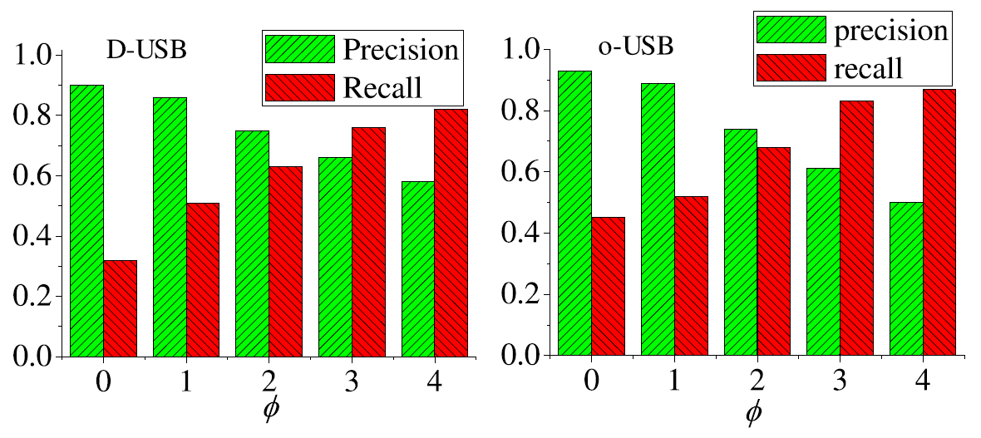
EXPERIMENTS
1. Discriminative Power of 24-Bit USB
Notes:
After extracting the usb and spatial feature, we can use it for image matching, because we has two aspects of information, the usb and spatial feature, we propose a cascade verification strategy. The basic idea is correct matches should be similar in visual feature and spatial configuration. Therefore, for two interest point, we first match their usb feature, if the hamming distance is less than a threshould, we then verify their spatial features. To verify the spatial feature, we pickup one neighbor keypoint from a and b then verify the spatial feature, orientation relationiship and distance relationship gradually. The neighbor keypoints passing these verifications are regarded as a correct match.
Because there are C neighbor keypoints in spatial feature, we run at most c*c times of verification. The number of neighbor keypoints passing verification is defined as the match order.

Slide 25
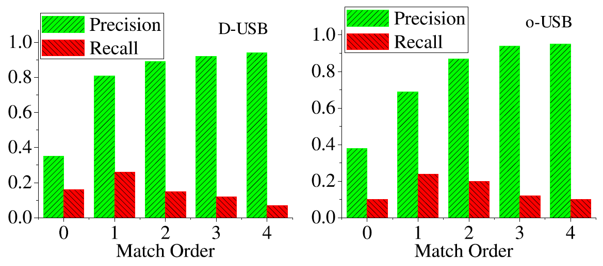
EXPERIMENTS
2. USB Plus Cascade Verification
Notes:
After extracting the usb and spatial feature, we can use it for image matching, because we has two aspects of information, the usb and spatial feature, we propose a cascade verification strategy. The basic idea is correct matches should be similar in visual feature and spatial configuration. Therefore, for two interest point, we first match their usb feature, if the hamming distance is less than a threshould, we then verify their spatial features. To verify the spatial feature, we pickup one neighbor keypoint from a and b then verify the spatial feature, orientation relationiship and distance relationship gradually. The neighbor keypoints passing these verifications are regarded as a correct match.
Because there are C neighbor keypoints in spatial feature, we run at most c*c times of verification. The number of neighbor keypoints passing verification is defined as the match order.

Slide 26
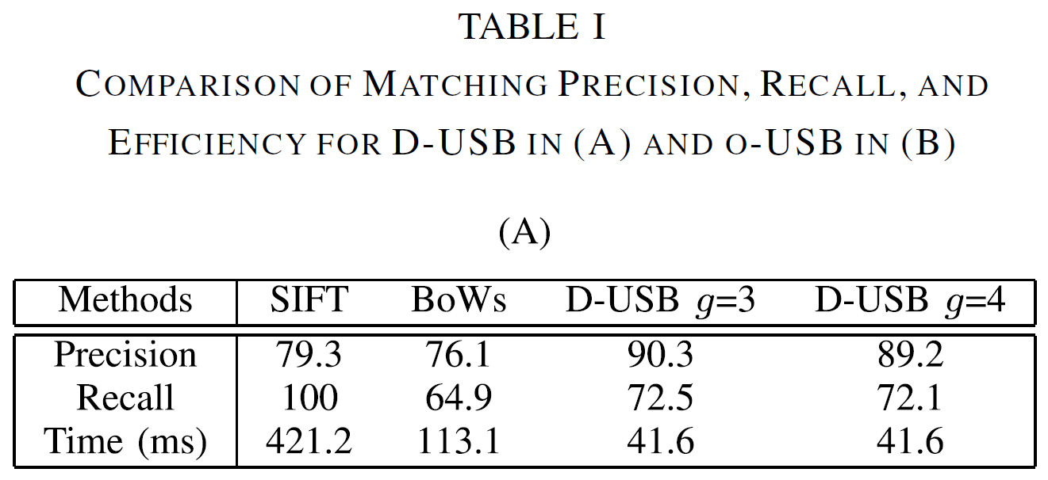
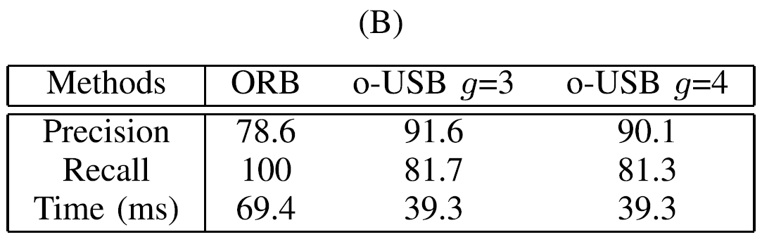
EXPERIMENTS
3. Comparisons
Notes:
After extracting the usb and spatial feature, we can use it for image matching, because we has two aspects of information, the usb and spatial feature, we propose a cascade verification strategy. The basic idea is correct matches should be similar in visual feature and spatial configuration. Therefore, for two interest point, we first match their usb feature, if the hamming distance is less than a threshould, we then verify their spatial features. To verify the spatial feature, we pickup one neighbor keypoint from a and b then verify the spatial feature, orientation relationiship and distance relationship gradually. The neighbor keypoints passing these verifications are regarded as a correct match.
Because there are C neighbor keypoints in spatial feature, we run at most c*c times of verification. The number of neighbor keypoints passing verification is defined as the match order.

Slide 27
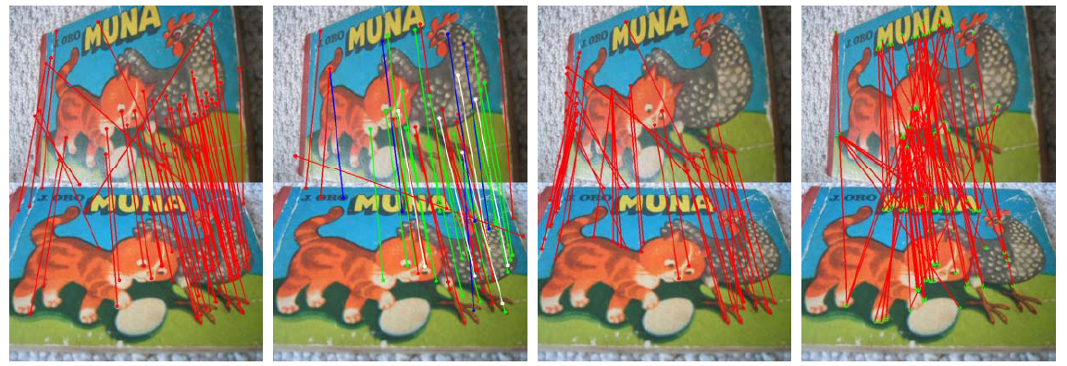
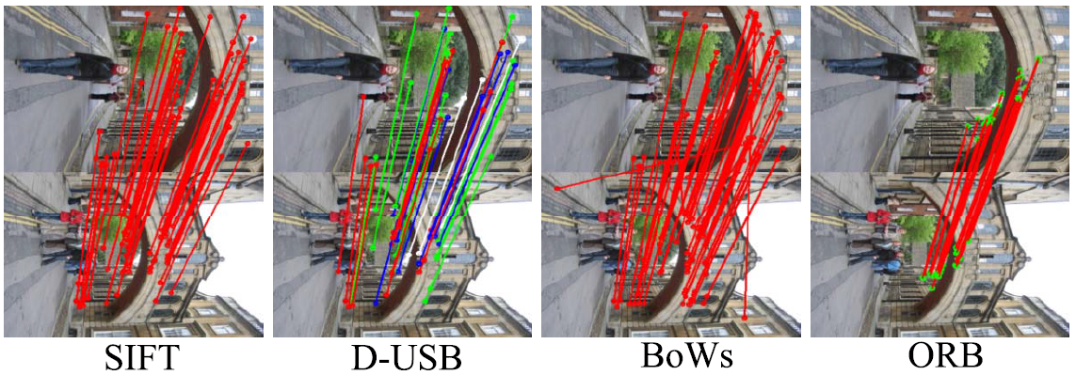
D-USB ：
red: 1-order match, green: 2-order match, blue: 3-order match, white: 4-order match.
Notes:
After extracting the usb and spatial feature, we can use it for image matching, because we has two aspects of information, the usb and spatial feature, we propose a cascade verification strategy. The basic idea is correct matches should be similar in visual feature and spatial configuration. Therefore, for two interest point, we first match their usb feature, if the hamming distance is less than a threshould, we then verify their spatial features. To verify the spatial feature, we pickup one neighbor keypoint from a and b then verify the spatial feature, orientation relationiship and distance relationship gradually. The neighbor keypoints passing these verifications are regarded as a correct match.
Because there are C neighbor keypoints in spatial feature, we run at most c*c times of verification. The number of neighbor keypoints passing verification is defined as the match order.

Slide 28
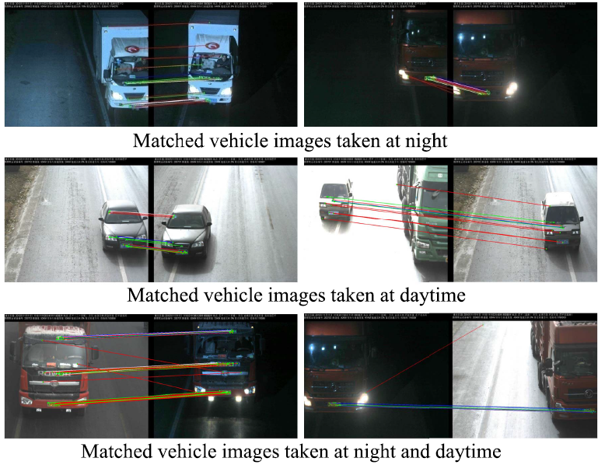
Notes:
After extracting the usb and spatial feature, we can use it for image matching, because we has two aspects of information, the usb and spatial feature, we propose a cascade verification strategy. The basic idea is correct matches should be similar in visual feature and spatial configuration. Therefore, for two interest point, we first match their usb feature, if the hamming distance is less than a threshould, we then verify their spatial features. To verify the spatial feature, we pickup one neighbor keypoint from a and b then verify the spatial feature, orientation relationiship and distance relationship gradually. The neighbor keypoints passing these verifications are regarded as a correct match.
Because there are C neighbor keypoints in spatial feature, we run at most c*c times of verification. The number of neighbor keypoints passing verification is defined as the match order.

Slide 29
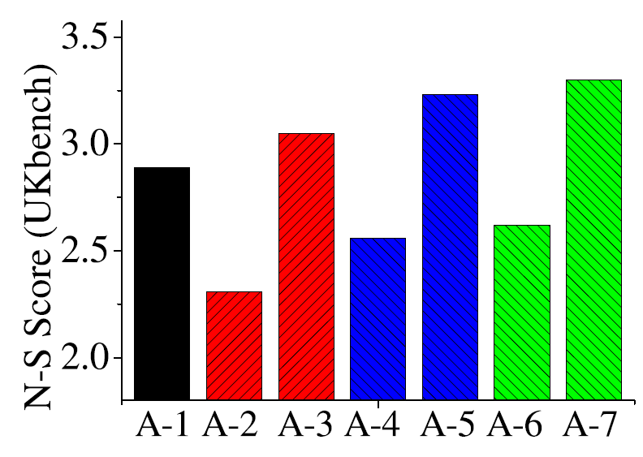
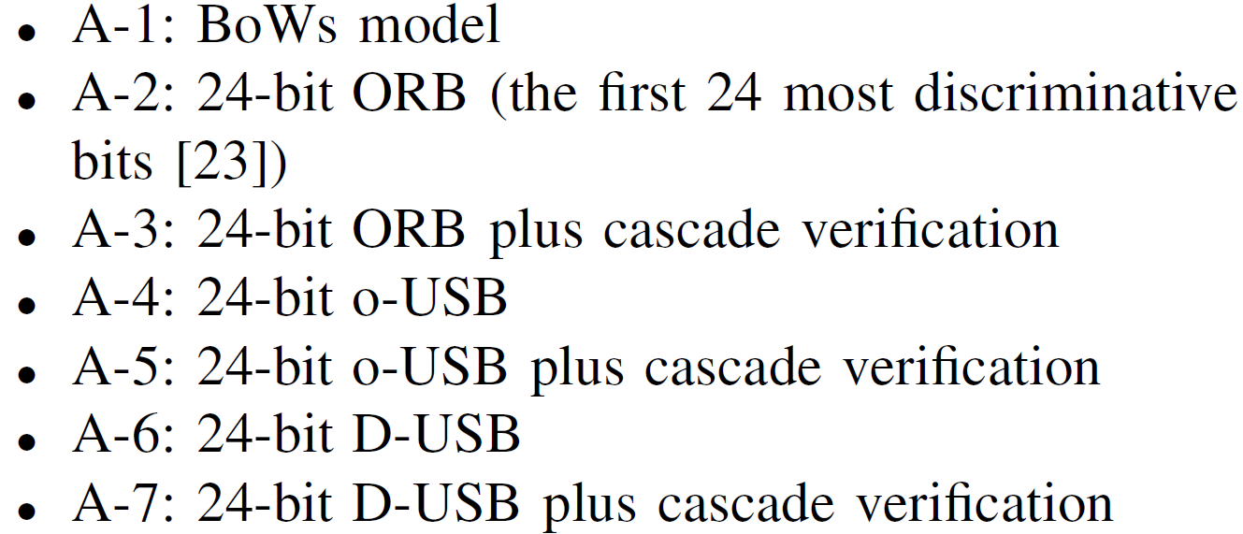
EXPERIMENTS
3. Image Retrieval
φ = 3. σ = 0.3
Notes:
After extracting the usb and spatial feature, we can use it for image matching, because we has two aspects of information, the usb and spatial feature, we propose a cascade verification strategy. The basic idea is correct matches should be similar in visual feature and spatial configuration. Therefore, for two interest point, we first match their usb feature, if the hamming distance is less than a threshould, we then verify their spatial features. To verify the spatial feature, we pickup one neighbor keypoint from a and b then verify the spatial feature, orientation relationiship and distance relationship gradually. The neighbor keypoints passing these verifications are regarded as a correct match.
Because there are C neighbor keypoints in spatial feature, we run at most c*c times of verification. The number of neighbor keypoints passing verification is defined as the match order.

Slide 30
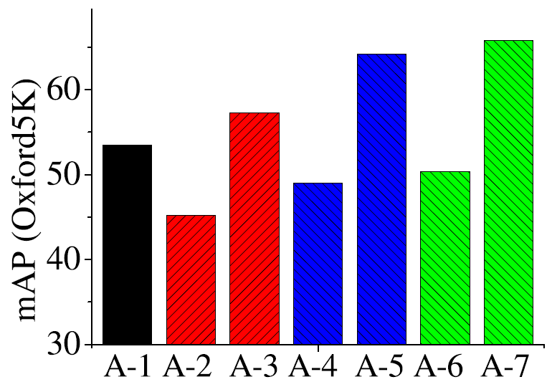
EXPERIMENTS
3. Image Retrieval
φ = 3. σ = 0.3
Notes:
After extracting the usb and spatial feature, we can use it for image matching, because we has two aspects of information, the usb and spatial feature, we propose a cascade verification strategy. The basic idea is correct matches should be similar in visual feature and spatial configuration. Therefore, for two interest point, we first match their usb feature, if the hamming distance is less than a threshould, we then verify their spatial features. To verify the spatial feature, we pickup one neighbor keypoint from a and b then verify the spatial feature, orientation relationiship and distance relationship gradually. The neighbor keypoints passing these verifications are regarded as a correct match.
Because there are C neighbor keypoints in spatial feature, we run at most c*c times of verification. The number of neighbor keypoints passing verification is defined as the match order.

Slide 31
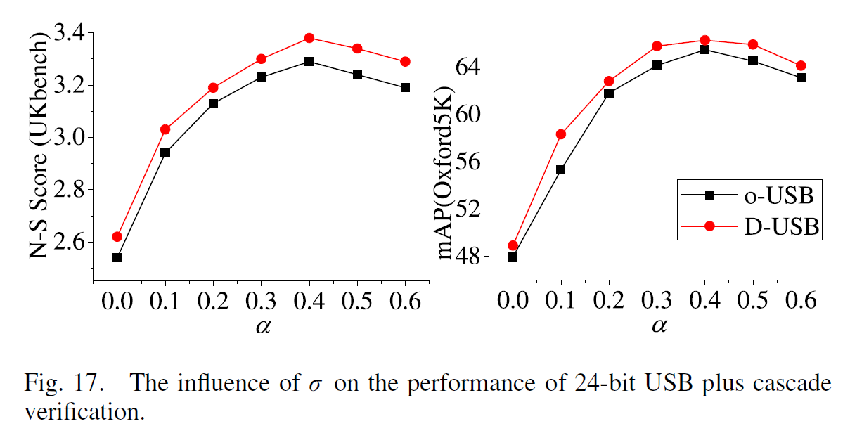
EXPERIMENTS
4. We test the influence of σ on the performance of the 24-bit USB plus cascade verification
Notes:
After extracting the usb and spatial feature, we can use it for image matching, because we has two aspects of information, the usb and spatial feature, we propose a cascade verification strategy. The basic idea is correct matches should be similar in visual feature and spatial configuration. Therefore, for two interest point, we first match their usb feature, if the hamming distance is less than a threshould, we then verify their spatial features. To verify the spatial feature, we pickup one neighbor keypoint from a and b then verify the spatial feature, orientation relationiship and distance relationship gradually. The neighbor keypoints passing these verifications are regarded as a correct match.
Because there are C neighbor keypoints in spatial feature, we run at most c*c times of verification. The number of neighbor keypoints passing verification is defined as the match order.

Slide 32
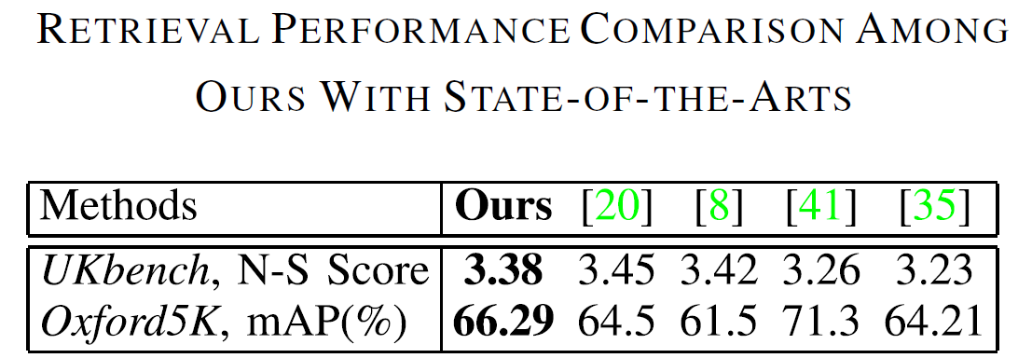
EXPERIMENTS
3. Image Retrieval
φ = 3. σ = 0.4. C = 4
Notes:
After extracting the usb and spatial feature, we can use it for image matching, because we has two aspects of information, the usb and spatial feature, we propose a cascade verification strategy. The basic idea is correct matches should be similar in visual feature and spatial configuration. Therefore, for two interest point, we first match their usb feature, if the hamming distance is less than a threshould, we then verify their spatial features. To verify the spatial feature, we pickup one neighbor keypoint from a and b then verify the spatial feature, orientation relationiship and distance relationship gradually. The neighbor keypoints passing these verifications are regarded as a correct match.
Because there are C neighbor keypoints in spatial feature, we run at most c*c times of verification. The number of neighbor keypoints passing verification is defined as the match order.

Slide 33
EXPERIMENTS
4. Large-Scale Image Retrieval
Distractors : 1.2 million Flickr images
Dataset : UKbench, Oxford5K, and our partial-duplicate image dataset
Notes:
After extracting the usb and spatial feature, we can use it for image matching, because we has two aspects of information, the usb and spatial feature, we propose a cascade verification strategy. The basic idea is correct matches should be similar in visual feature and spatial configuration. Therefore, for two interest point, we first match their usb feature, if the hamming distance is less than a threshould, we then verify their spatial features. To verify the spatial feature, we pickup one neighbor keypoint from a and b then verify the spatial feature, orientation relationiship and distance relationship gradually. The neighbor keypoints passing these verifications are regarded as a correct match.
Because there are C neighbor keypoints in spatial feature, we run at most c*c times of verification. The number of neighbor keypoints passing verification is defined as the match order.

Slide 34
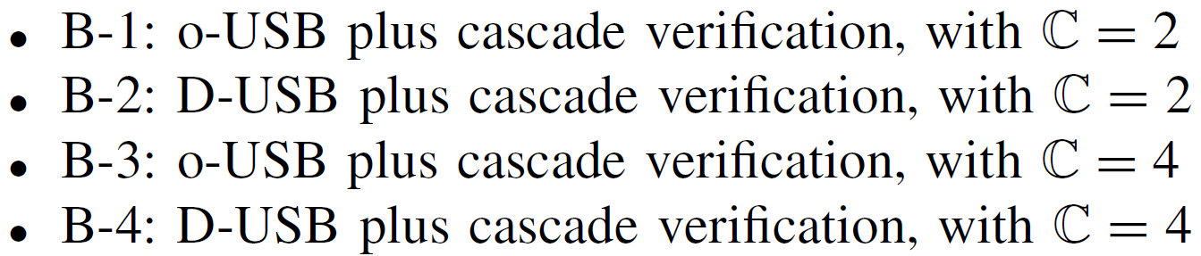


EXPERIMENTS
4. Large-Scale Image Retrieval
The experimental results of large-scale image search on Ukbench dataset PLUS 1.2 million FLICKR images
Notes:
After extracting the usb and spatial feature, we can use it for image matching, because we has two aspects of information, the usb and spatial feature, we propose a cascade verification strategy. The basic idea is correct matches should be similar in visual feature and spatial configuration. Therefore, for two interest point, we first match their usb feature, if the hamming distance is less than a threshould, we then verify their spatial features. To verify the spatial feature, we pickup one neighbor keypoint from a and b then verify the spatial feature, orientation relationiship and distance relationship gradually. The neighbor keypoints passing these verifications are regarded as a correct match.
Because there are C neighbor keypoints in spatial feature, we run at most c*c times of verification. The number of neighbor keypoints passing verification is defined as the match order.

Slide 35

EXPERIMENTS
4. Large-Scale Image Retrieval
The experimental results of large-scale image search on Oxford5K dataset PLUS 1.2 million FLICKR images
Notes:
After extracting the usb and spatial feature, we can use it for image matching, because we has two aspects of information, the usb and spatial feature, we propose a cascade verification strategy. The basic idea is correct matches should be similar in visual feature and spatial configuration. Therefore, for two interest point, we first match their usb feature, if the hamming distance is less than a threshould, we then verify their spatial features. To verify the spatial feature, we pickup one neighbor keypoint from a and b then verify the spatial feature, orientation relationiship and distance relationship gradually. The neighbor keypoints passing these verifications are regarded as a correct match.
Because there are C neighbor keypoints in spatial feature, we run at most c*c times of verification. The number of neighbor keypoints passing verification is defined as the match order.

Slide 36

EXPERIMENTS
4. Large-Scale Image Retrieval
The experimental results of large-scale image search on partial-duplicate dataset PLUS 1.2 million FLICKR images
Notes:
After extracting the usb and spatial feature, we can use it for image matching, because we has two aspects of information, the usb and spatial feature, we propose a cascade verification strategy. The basic idea is correct matches should be similar in visual feature and spatial configuration. Therefore, for two interest point, we first match their usb feature, if the hamming distance is less than a threshould, we then verify their spatial features. To verify the spatial feature, we pickup one neighbor keypoint from a and b then verify the spatial feature, orientation relationiship and distance relationship gradually. The neighbor keypoints passing these verifications are regarded as a correct match.
Because there are C neighbor keypoints in spatial feature, we run at most c*c times of verification. The number of neighbor keypoints passing verification is defined as the match order.

Slide 37

Good Matching Performance
检索图像
45 bit binary descriptor
Notes:
The raw descriptor is the basis of our USB thefore, we have to make sure it is discrimiantive enough. We test it image matching, and find it produces surprising good matching performance. This are some comparsions between it and SIFT. We can observe that it produces almost the same matching result with SIFT.

Slide 38




Good Matching Performance
45 bit binary descriptor
SIFT
Notes:
The raw descriptor is the basis of our USB thefore, we have to make sure it is discrimiantive enough. We test it image matching, and find it produces surprising good matching performance. This are some comparsions between it and SIFT. We can observe that it produces almost the same matching result with SIFT.

Slide 39
CONCLUSIONS
USBs directly compresses the visual clues of keypoints into an ultra compact 24-bit representation .
45 bit binary descriptor
The auxiliary spatial feature effectively captures the spatial configuration in the neighbor region of the keypoint into a 64-bit representation, hence could be utilized to remove the mismatched USBs in cascade verification .
Proposed BoUs model outperforms BoWs model in the aspects of recall, accuracy and efficiency .
Notes:
The raw descriptor is the basis of our USB thefore, we have to make sure it is discrimiantive enough. We test it image matching, and find it produces surprising good matching performance. This are some comparsions between it and SIFT. We can observe that it produces almost the same matching result with SIFT.

Slide 40
CONCLUSIONS
45 bit binary descriptor
In our future work, we will design a learning strategy to further maximize the discriminative clues preserved in USB.
One possible strategy is to optimize the 24-bit descriptor by making it produce similar distance measurements with the raw SIFT descriptor.
Notes:
The raw descriptor is the basis of our USB thefore, we have to make sure it is discrimiantive enough. We test it image matching, and find it produces surprising good matching performance. This are some comparsions between it and SIFT. We can observe that it produces almost the same matching result with SIFT.

Slide 41


